Slide 1
Hybrid Regression Model for Soil Moisture Quantity Prediction

Slide 2
INTRODUCTION
There are different factors that affect the production of good quality and quantity of crops.
Growth of plant cells are affected by the scarcity soil moisture, which reduces the plant growth.
The key challenge is to optimize the uses of natural resources & meet the increasing demand of crops.
In the current study, we propose a hybrid regression model to enhance the performance of existing regression models for soil moisture quantity

Slide 3
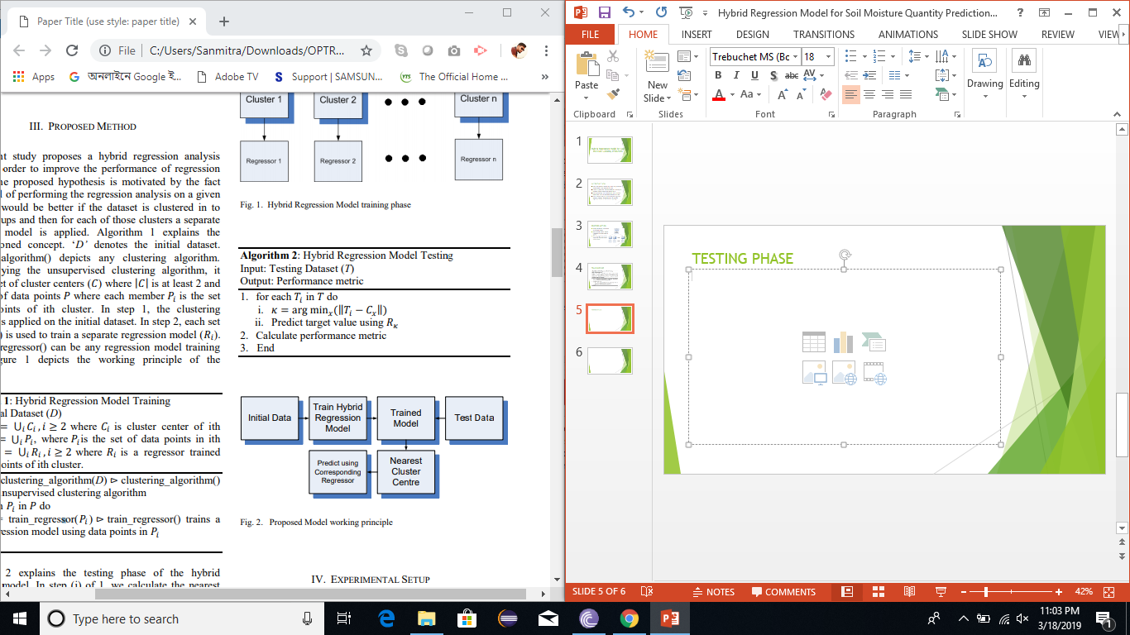
PROPOSED METHOD

Slide 4
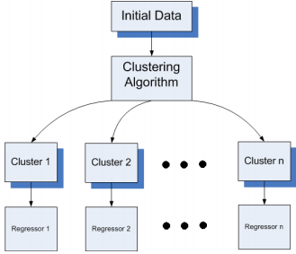
INITIAL PHASE
Initially the dataset is unsupervisedly clustered in to natural groups.
Then for each of those clusters a separate regression model is applied.
The train_regressor() method can be any regression model training phase.

Slide 5
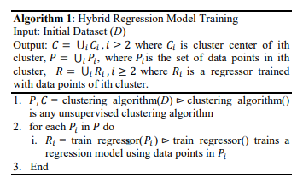
TRAINING PHASE

Slide 6
TESTING PHASE

Slide 7

RMSE VS. NUMBER OF CLUSTERS
Value of K in k-means clustering is important in getting the best cluster results.
Starting with an initial k value of 2, varied between 2 to 18 at interval of 4.
For each k value the resultant RMSE value of the hybrid model has been calculated.
K MODEL | 2 | 6 | 10 | 14 | 18
DT | 0.00301 | 0.002852 | 0.002480 | 0.003346 | 0.003798
MLP | 1.826 | 1.708 | 1.512 | 1.661 | 1.445
LR | 0.00678 | 0.005381 | 0.004453 | 0.003840 | 0.003699
KNN | 0.00641 | 0.006007 | 0.005884 | 0.006162 | 0.005555
SVM | 0.01956 | 0.016453 | 0.012573 | 0.011341 | 0.009735

Slide 8
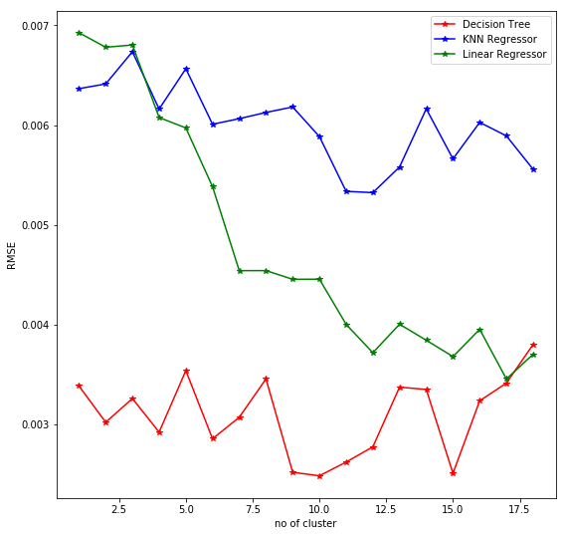
RMSE VS. NUMBER OF CLUSTERS
Increasing the number of clusters, the error i.e. the RMSE is minimized.
For this study k value has been chosen as 10 as it gives the best result.

Slide 9
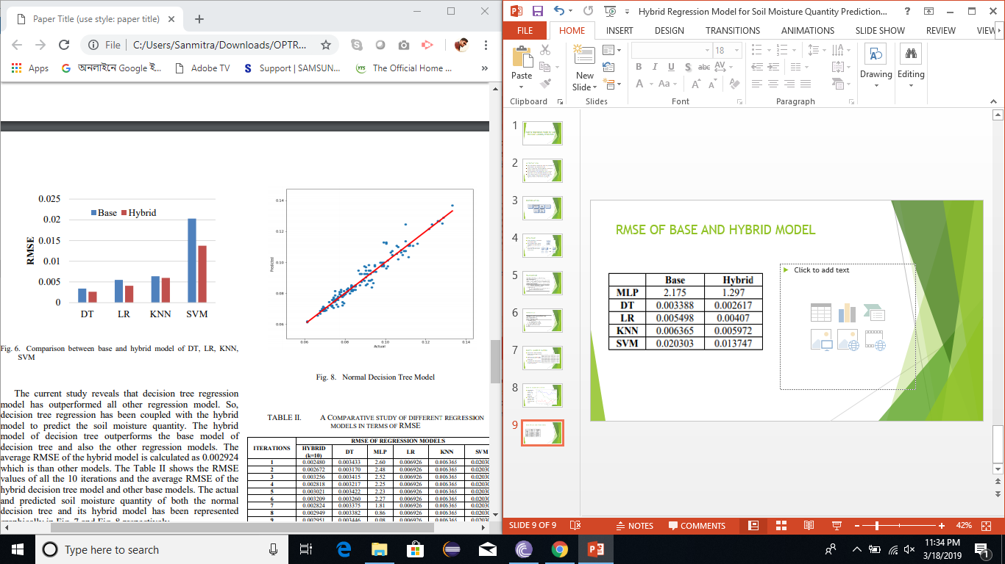
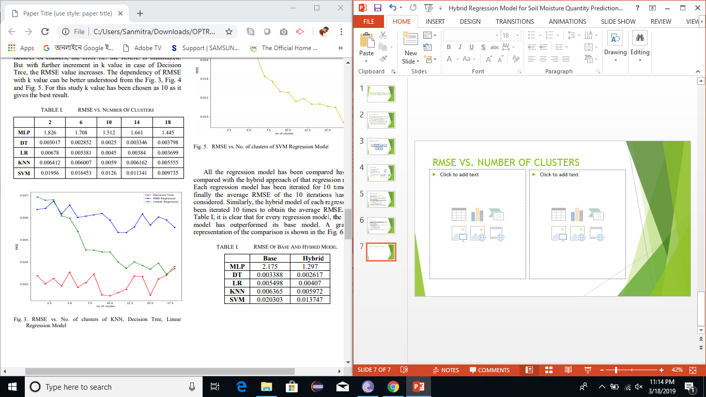
RMSE OF BASE AND HYBRID MODEL

Slide 10
HYBRID DT VS OTHER REGRESSION MODELS
ITERATIONS | RMSE OF REGRESSION MODELS
 | HYBRID(k=10) | DT | MLP | LR | KNN | SVM
1 | 0.002480 | 0.003433 | 2.60 | 0.006926 | 0.006365 | 0.020303
2 | 0.002672 | 0.003170 | 2.48 | 0.006926 | 0.006365 | 0.020303
3 | 0.003256 | 0.003415 | 2.52 | 0.006926 | 0.006365 | 0.020303
4 | 0.002818 | 0.003217 | 2.25 | 0.006926 | 0.006365 | 0.020303
5 | 0.003021 | 0.003422 | 2.23 | 0.006926 | 0.006365 | 0.020303
6 | 0.003209 | 0.003260 | 2.27 | 0.006926 | 0.006365 | 0.020303
7 | 0.002824 | 0.003375 | 1.81 | 0.006926 | 0.006365 | 0.020303
8 | 0.002949 | 0.003382 | 0.86 | 0.006926 | 0.006365 | 0.020303
9 | 0.002951 | 0.003446 | 0.08 | 0.006926 | 0.006365 | 0.020303
10 | 0.003064 | 0.003422 | 0.04 | 0.006926 | 0.006365 | 0.020303
AVERAGE | 0.002924 | 0.003354 | 1.71 | 0.006926 | 0.006365 | 0.020303

Slide 11
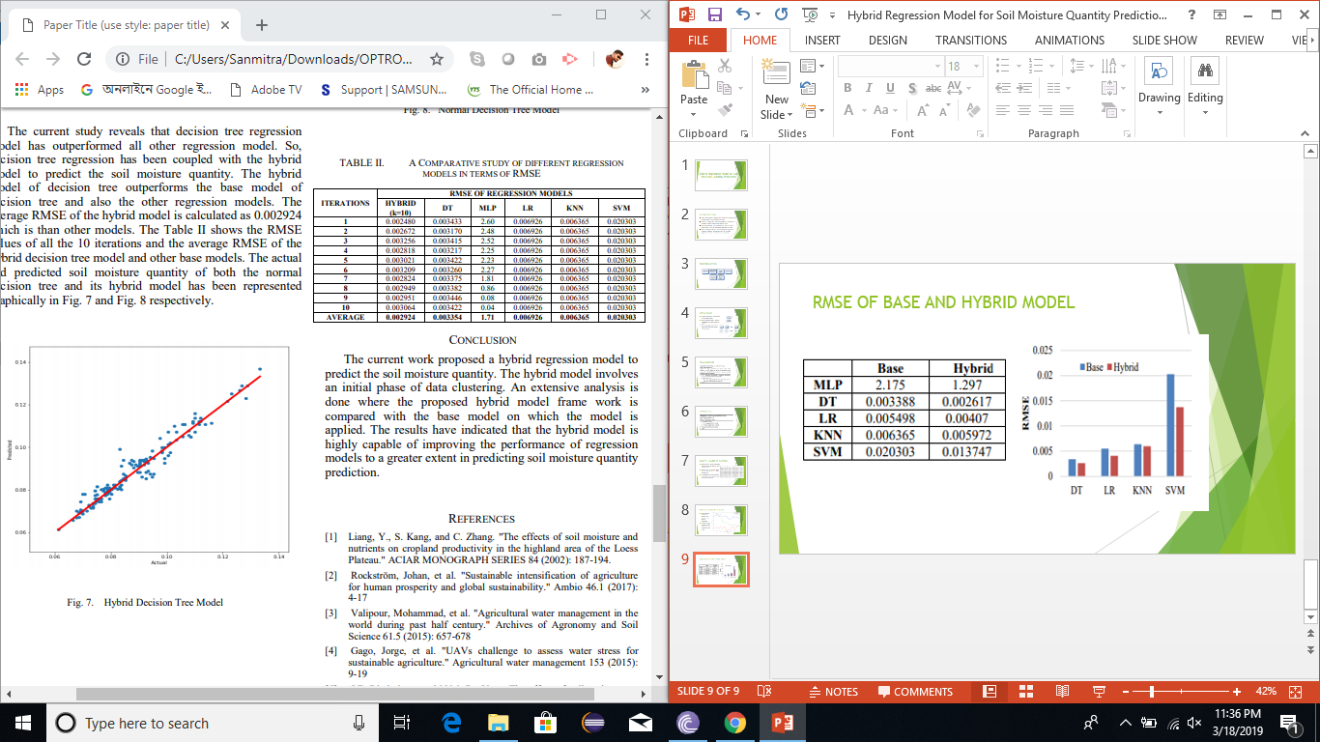
BASE DT VS HYBRID DT MODEL
Normal Decision Tree Model
Hybrid Decision Tree Model

Slide 12
CONCLUSION
The current work proposed a hybrid regression model to predict the soil moisture quantity. The hybrid model involves an initial phase of data clustering. An extensive analysis is done where the proposed hybrid model frame work is compared with the base model on which the model is applied. The results have indicated that the hybrid model is highly capable of improving the performance of regression models to a greater extent in predicting soil moisture quantity prediction.

Slide 13
THANK YOU

